Slide 1


Efran Himel
12-15-2022

Slide 2

Outline
Executive Summary
Introduction
Methodology
Results
Conclusion
Appendix

Slide 3
Executive Summary
To determine the success of Class 1 SpaceX rocket launches, I pulled data from public sources (SpaceX, Wikipedia). Then I conducted an initial exploratory analysis of the extracted data to gain a deeper understanding of it. This is done cleaning it, producing initial statistic metrics, and creating dashboards. Finally, the data is fed into various Classification ML models to predict which features had the highest chance of a successful launch.
After producing several ML models, they all performed equally well producing a score of 83.333 (except for the tree model) so the Logistic Regression model was chosen at the end due to its superior interpretability over the other models. The top 10 features from the model that had the highest impact on launch success were [Serial_B1003,Serial_B1015,Serial_B1016,Serial_B0003,Serial_B1023,Orbit_HEO,Serial_B1038,Serial_B1026,Serial_B1012,LandingPad_5e9e3032383ecb761634e7cb]

Slide 4
Introduction
In this capstone, I predicted if the Falcon 9 first stage will land successfully. SpaceX advertises Falcon 9 rocket launches on its website with a cost of 62 million dollars; other providers cost upward of 165 million dollars each, much of the savings is because SpaceX can reuse the first stage. Therefore, if I can determine if the first stage will land, I can determine the cost of a launch. This information can be used if an alternate company (SpaceY) wants to bid against SpaceX for a rocket launch

Slide 5

Section 1

Slide 6
Methodology
Executive Summary
Data collection methodology:
Public data was used for this project. It was collected from the SpaceX API and SpaceX wiki page using request & beatifulsoup4 library
Perform data wrangling
The data was wrangled by filtering irrelevant fields, reformatting strings, and interpolating missing values based on existing data.
Perform exploratory data analysis (EDA) using visualization and SQL
Perform interactive visual analytics using Folium and Plotly Dash
Perform predictive analysis using classification models
Sklearn and GridSearch were used to for classification modeling and tuning

Slide 7
Data Collection
How data sets were collected.
The data was collected from the SpaceX API using the python requests library and web scraping the SpaceX Wikipedia page using requests API and beautifulsoup4 libraries
Data collection process
Space Data Collection: Make API call to get IDs of SpaceX flights. Use IDs to make API calls to retrieve ['rocket', 'payloads', 'launchpad', 'cores', 'flight_number', 'date_utc’] data. With this dataset, filter for only Falcon 9 rockets. Interpolate any missing values for ‘payloads’ by replacing with the mean of ‘payloads’
Wikipedia Data Collection: Use beautifulsoup4 to extract html data from SpaceX wiki page to retrieve data from table regarding launch history. After parsing through html, create dataframe of data. Data included the following columns extracted from Wiki ['Flight No.’, 'Launch site’, 'Payload’, 'Payload mass’, 'Orbit’, 'Customer’, 'Launch outcome’, 'Version Booster’, 'Booster landing’, 'Date’, 'Time’,]

Slide 8
Data Collection – SpaceX API
Called API to get list of launches & IDS
Used IDs and made calls to https://api.spacexdata.com/v4/launchpads/ with launch IDs to get [booster version, launch site, payload, core data]
Filter for Falcon 9
Payload had missing data so used mean to interpolate missing data
GitHub Code Link
API Call to Get IDs
Remove & Clean Data
Remove & Clean Data
API Get Payload
API Get Launch Site
API Get Booster Version
API Get Core Data
Filter for Falcon 9
Interpolate Payload

Slide 9
Data Collection - Scraping
Used beautifulsoup4 & requests library to extract html data from Wiki
Parsed through Wiki html to retrieve data from launch history table
Converted data into a dictionary. Cleaned some data during conversion process (converting to string, making more readable)
Converted dictionary into pandas data frame and saved as csv
GitHub Code Link
HTML pull of SpaceX Wiki
Parsed HTML Wiki
Retrieved Launch History Data from HTML
Saved as CSV
Converted to Data Frame
Stored Data in Dictionary

Slide 10
Data Wrangling
Initial Data processing was conducting while pulling data from sources (see info and notebook links from slides 8 & 9 for more details)
After the dataset was extracted from the SpaceX API and Wikipedia, additional data processing was conducted.
A few initial calculations were conducted.
Conducted value counts for [Launch Site, Orbit, Outcome]
Based on landing outcome, created a ‘Class’ column where 0 = bad outcome and 1 = otherwise
Flow Chart
GitHub Link
API & Wiki Pulls + Data Wrangling
Save Data Set
Initial Counts
Class Column based on Outcomes Column

Slide 11
EDA with Data Visualization
For EDA several scatter plots were created, one bar chart was created, and one line chart was created
Scatter Plots: Scatter plots were used to understand the relationship between two variables with each other and used Class to distinguish between the launch failures and success. I compared (Flight Number, Launch Site), (Payload, Launch Site), (Flight Number, Orbit), (Payload, Orbit)
Bar Chart: The bar chart was used to understand the success rate of each orbit. ES-L1, GEO, HEO, SSO, VLEO had the highest success rate of 100%
Line Chart: The line chart was used to understand how the success rate of launches changed over time by year. From 2010 to 2020 there was a positive updard trend from 0% success rate in 2010 to about 80% in 2020
GitHub Link

Slide 12
EDA with SQL
SQL Queries were used to get a general idea various aspects of the data. The Following Queries were conducted.
Display the names of the unique launch sites in the space mission
Display 5 records where launch sites begin with the string 'CCA'
Display the total payload mass carried by boosters launched by NASA (CRS)
Display average payload mass carried by booster version F9 v1.1
List the date when the first successful landing outcome in ground pad was achieved.
Continue to Next Slide
GitHub Link

Slide 13
EDA with SQL
SQL Queries were used to get a general idea various aspects of the data. The Following Queries were conducted.
List the names of the boosters which have success in drone ship and have payload mass greater than 4000 but less than 6000
List the total number of successful and failure mission outcomes
List the names of the booster versions which have carried the maximum payload mass.
List the failed landing outcomes in drone ship, their booster versions, and launch site names for in year 2015
Rank the count of landing outcomes (such as Failure (drone ship) or Success (ground pad)) between the date 2010-06-04 and 2017-03-20, in descending order
GitHub Link

Slide 14
Build an Interactive Map with Folium
Folium was used to visualize the location of SpaceX launches for their Falcon 9 rockets. Map markers (circles & markers) were placed on a map to visualize the launch sites. Markers were also added for successful & failed launched
This was done to better visualize the locations of successful launches. This is important data for better understanding the geographic conditions of successful launches.
GitHub Link

Slide 15
Build a Dashboard with Plotly Dash
Another step in the EDA was creating a Plotly dashboard. I created a dashboard that included:
A Drop down for all or each individual launch site. This was to filter the data and see if there’s a relationship between launch success and site.
A Pie chart showing launch success. This helped visualize the results of the down filter.
A Slider to indicate launch payload range which helps understand if payload affected launch success.
A scatter plot indicating the success of launches based on payload mass and categorized by booster version,
GitHub Link

Slide 16
Predictive Analysis (Classification)
After prepping the data and conducting the initial analysis I created several ML classification models. I vectorized the X & Y data, normalized X, and split the data between train & test set. I used gridsearch to find the best parameters for logistic regressions, support vector machine, decision tree, and knn models. I compared their performance with a confusion matrix & best score method in sklearn. All the models except the decision tree got a final score of on the test set 0.8333. Decision tree scored 0.8888. I chose the tree model as the best model because it had the highest predictive score
GitHub Link

Slide 17
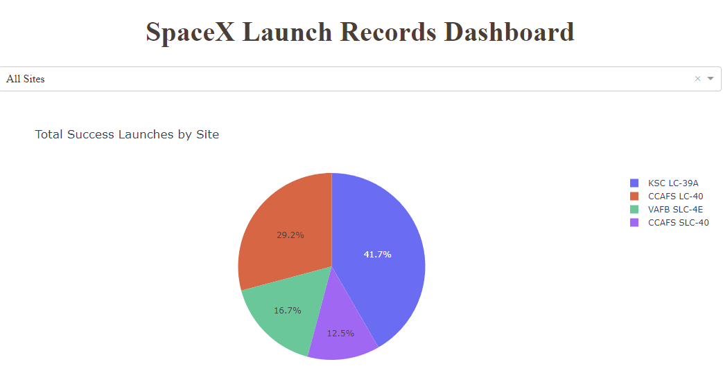
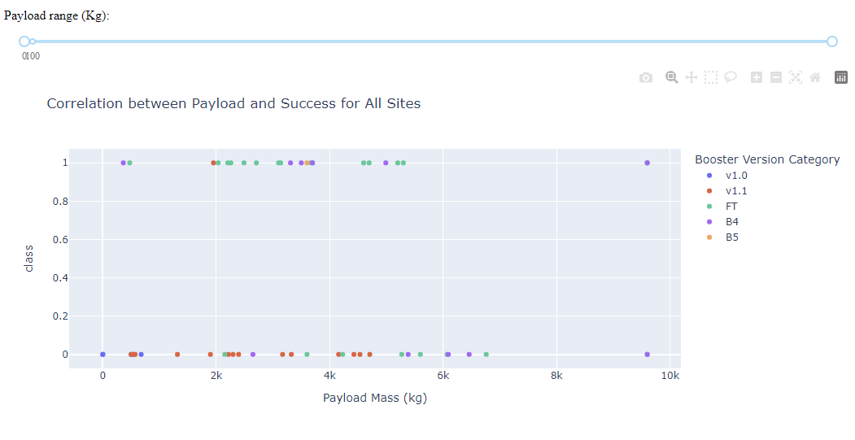

Results
Exploratory data analysis results & Interactive analytics demo in screenshots
Predictive analysis results: Tree model scored highest predictive score on test set with 88.89% accuracy

Slide 18

Section 2

Slide 19
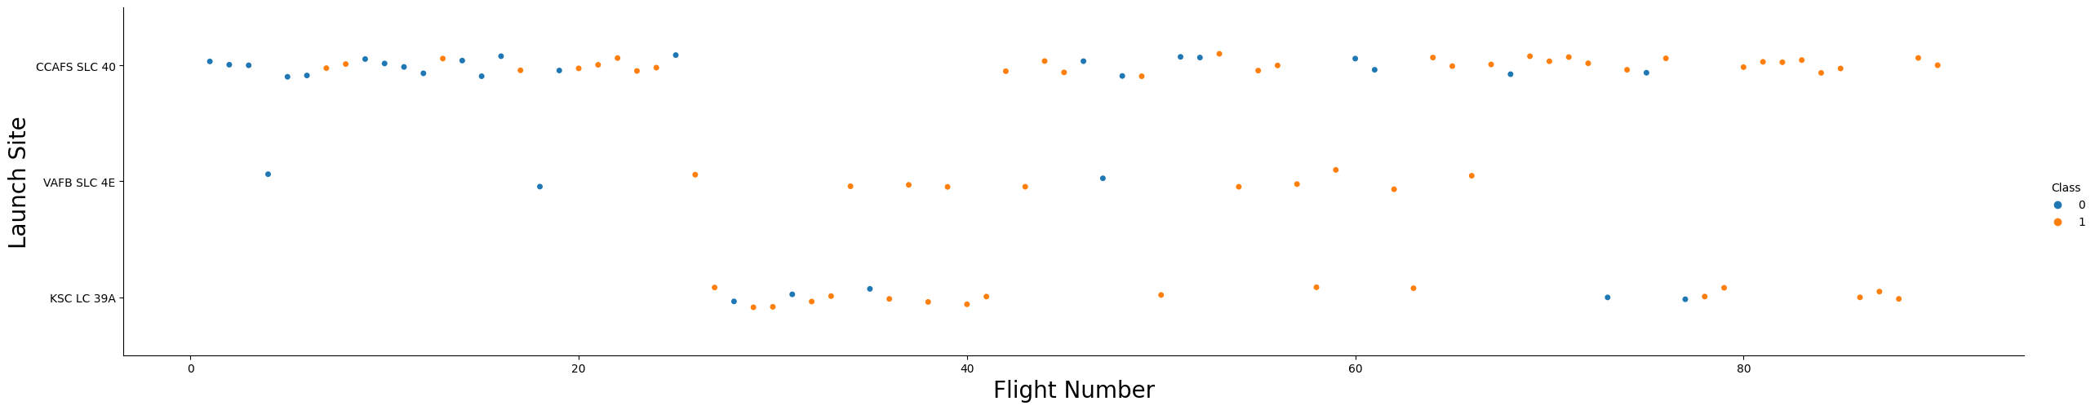
Flight Number vs. Launch Site
Show a scatter plot of Flight Number vs. Launch Site
CCAFS SLC 40 Had the greatest number of launches, and it seems the greatest number of successful flights as well. KSC LC 39A had the fewer launches but proportionally the most successful launches.

Slide 20
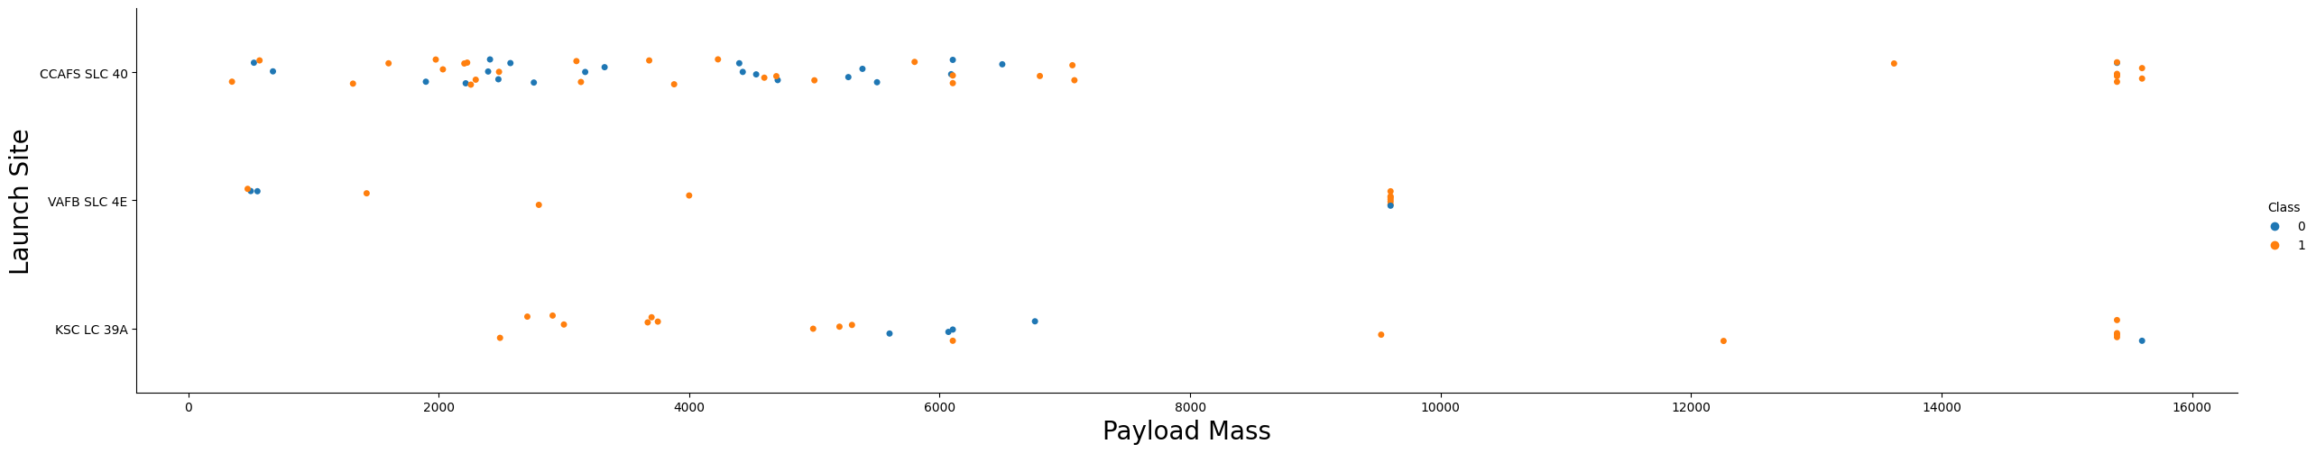
Payload vs. Launch Site
Show a scatter plot of Payload vs. Launch Site
Even though most launches are at lower payloads, there’s a proportionally higher number of successful launches at higher payloads.
CCASFS SLC 40 & KSC LC 39A both seem to be able to handle a wide variety of payloads while maintaining successful launches.

Slide 21
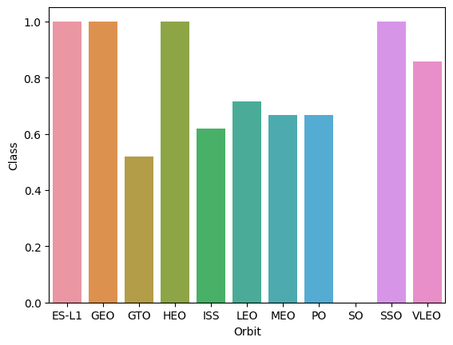
Success Rate vs. Orbit Type
Show a bar chart for the success rate of each orbit type
Based on the bar chart, orbits [ES-L1, GEO, HEO, SSO] have the highest success rate.
SO Has the lowest success rate

Slide 22
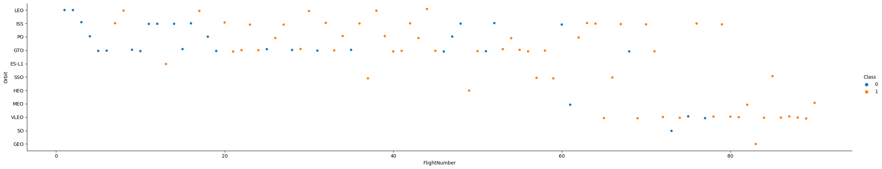
Flight Number vs. Orbit Type
Show a scatter point of Flight number vs. Orbit type
Even though [ES-L1, GEO, HEO, SSO] had the highest success rate in the bar chart, the scatter plot shows that they had few launches in total, so fewer potential chances of failure.
VLEO had the second highest success rate and a good number of launches, so it may be a better candidate.

Slide 23
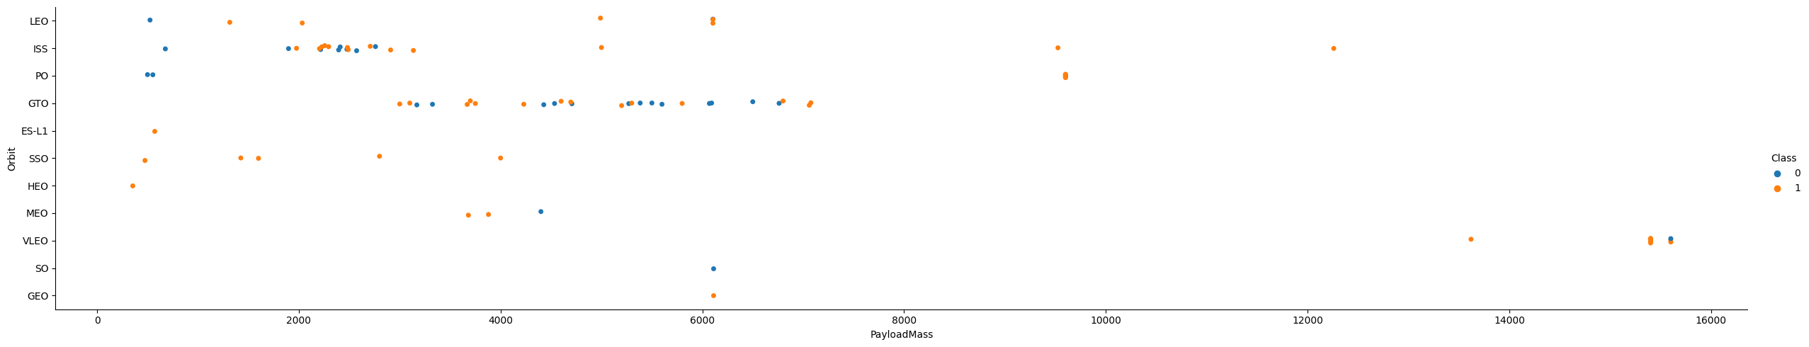
Payload vs. Orbit Type
Show a scatter point of payload vs. orbit type
Most the data is concentrated in the upper left corner of the plot. Seems like most launches are focused on lower orbit lower weight payloads vs high orbit high weight payloads.
Higher weight payloads seems to be more successful. Potentially do to practice/experience from lower weight payloads?

Slide 24
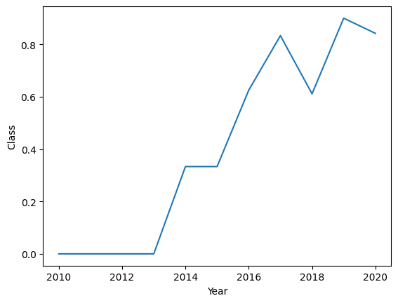
Launch Success Yearly Trend
Show a line chart of yearly average success rate
Over the years, the success rate of successful launches has gone up from 2010 to 2020

Slide 25
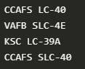
All Launch Site Names
Find the names of the unique launch sites
Present your query result with a short explanation here
Query: SELECT DISTINCT Launch_Site from spacex
Explanation: selects the distinct values from the spacex table

Slide 26
Launch Site Names Begin with 'CCA'
Find 5 records where launch sites begin with `CCA`
Present your query result with a short explanation here
Query: SELECT * FROM spacex WHERE Launch_Site LIKE "CCA%" LIMIT 5
Explanation: selects all records from spacex table based on a filter then limits to 5 results

Slide 27
Total Payload Mass
Calculate the total payload carried by boosters from NASA
45596
Present your query result with a short explanation here
Query: SELECT SUM(PAYLOAD_MASS__KG_) FROM spacex WHERE Customer = "NASA (CRS)“
Explanation: Sums payload column from spacex table after a filter has been applied that only uses NASA as the customer

Slide 28
Average Payload Mass by F9 v1.1
Calculate the average payload mass carried by booster version F9 v1.1
2928.4
Present your query result with a short explanation here
Query: SELECT AVG(PAYLOAD_MASS__KG_) FROM spacex WHERE Booster_Version = "F9 v1.1“
Explanation: Averages payload column after the spacex table filtered the data by booster version

Slide 29
First Successful Ground Landing Date
Find the dates of the first successful landing outcome on ground pad
02-03-2019
Present your query result with a short explanation here
Query: SELECT MIN(Date) FROM spacex WHERE "Landing _Outcome" = "Success“
Explanation: Filters data for successful landing outcome then uses min to pick the earliest date

Slide 30
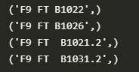
Successful Drone Ship Landing with Payload between 4000 and 6000
List the names of boosters which have successfully landed on drone ship and had payload mass greater than 4000 but less than 6000
Present your query result with a short explanation here
Query: SELECT Booster_Version FROM spacex WHERE "Landing _Outcome" = "Success (drone ship)" AND PAYLOAD_MASS__KG_ > 4000 AND PAYLOAD_MASS__KG_ < 6000
Explanation: Filtered by landing outcome and payload size then select the booster column

Slide 31
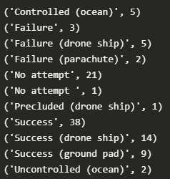
Total Number of Successful and Failure Mission Outcomes
Calculate the total number of successful and failure mission outcomes
Present your query result with a short explanation here
Query: SELECT "Landing _Outcome", COUNT("Landing _Outcome") FROM spacex GROUP BY "Landing _Outcome" ORDER BY "Landing _Outcome"
Explanation: Select landing outcome and count of landing outcome from spacex table. Then use group by landing outcome to get the count of success & failures. Order by was used to keep output organized

Slide 32
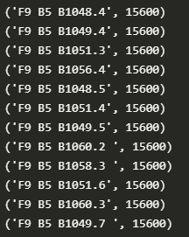
Boosters Carried Maximum Payload
List the names of the booster which have carried the maximum payload mass
Present your query result with a short explanation here
Query: SELECT Booster_Version, PAYLOAD_MASS__KG_ FROM spacex WHERE PAYLOAD_MASS__KG_ = (SELECT MAX(PAYLOAD_MASS__KG_) FROM spacex)
Explanation: Used sub query to get max payload then used another query to get all booster versions that had that max payload from the sub query

Slide 33
2015 Launch Records
List the failed landing_outcomes in drone ship, their booster versions, and launch site names for in year 2015
('Failure (drone ship)', 'F9 v1.1 B1012', 'CCAFS LC-40', '10-01-2015')
('Failure (drone ship)', 'F9 v1.1 B1015', 'CCAFS LC-40', '14-04-2015')
Present your query result with a short explanation here
Query: SELECT "Landing _Outcome", Booster_Version, Launch_Site, Date FROM spacex WHERE "Landing _Outcome" = "Failure (drone ship)" AND Date LIKE "%2015“
Explanation: Used where to filter landing outcome and date and then selected all relevant columns for query

Slide 34
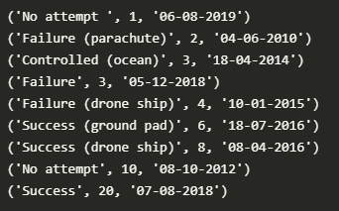
Rank Landing Outcomes Between 2010-06-04 and 2017-03-20
Rank the count of landing outcomes (such as Failure (drone ship) or Success (ground pad)) between the date 2010-06-04 and 2017-03-20, in descending order
Present your query result with a short explanation here
Query: SELECT "Landing _Outcome", COUNT("Landing _Outcome") as c, Date FROM spacex WHERE Date >= '04-06-2010' AND Date <= '20-03-2017’ GROUP BY "Landing _Outcome" ORDER BY "c“
Explanation: Used Where to get current date range. Selected relevant columns and group by to count outcomes for each category. Used order by to then rank the outcomes

Slide 35

Section 3

Slide 36
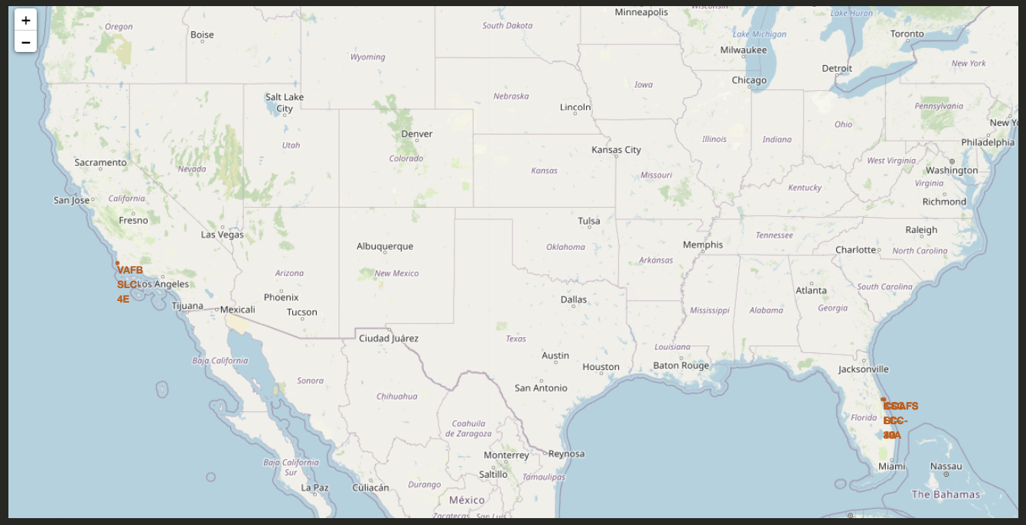
All Launch Sites on a Map
Explore the generated folium map and make a proper screenshot to include all launch sites’ location markers on a global map
It seems the important launch sites on concentrated in a few states (CA and FL). This may be because the states have ideal launch conditions for rockets.

Slide 37
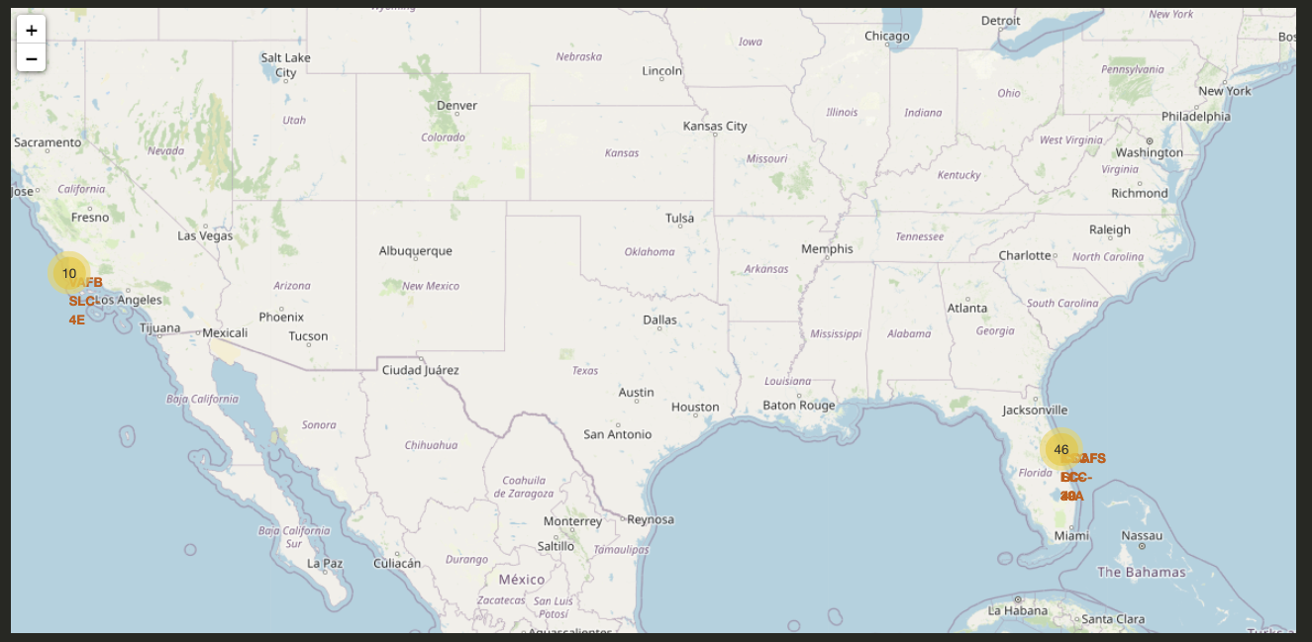
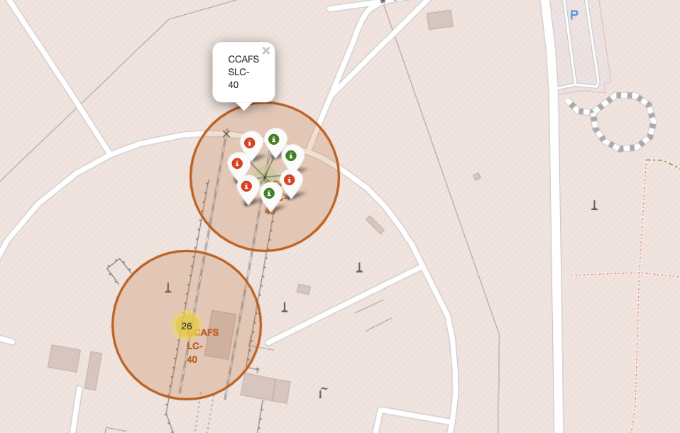
Successful & Failed Launches per Site
This screenshot indicates where there were more successful launches. It seems Florida had more launches and more successful launches there than California launch locations

Slide 38

Section 4

Slide 39
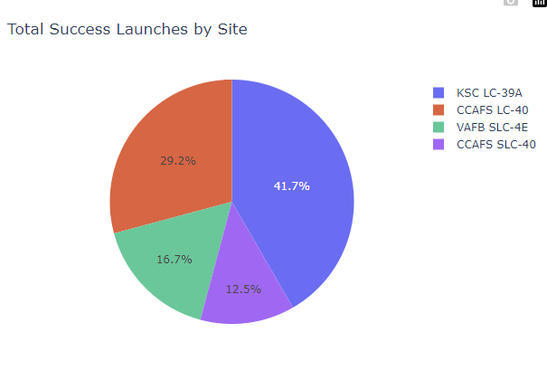
Total Success Launches by Site
This screenshot shows that KSC LC-39A & CCAFS LC-40 had the highest portion of launches from all the 4 launch sites.
KSC LC-39A had the greatest number of launches in total
CCAFS LC-40 had the second most

Slide 40
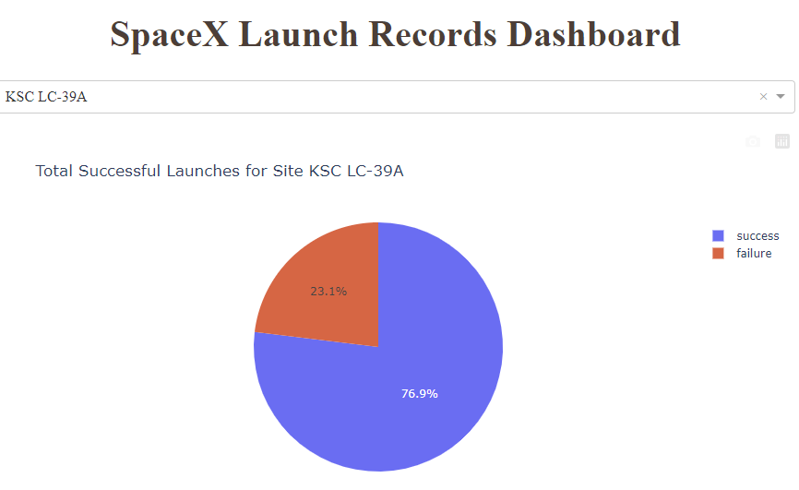
Launch Site with Highest Success Rate
Out of all the launch sites, KSC LC-39A had the highest success rate out of the 4 launch locations.

Slide 41
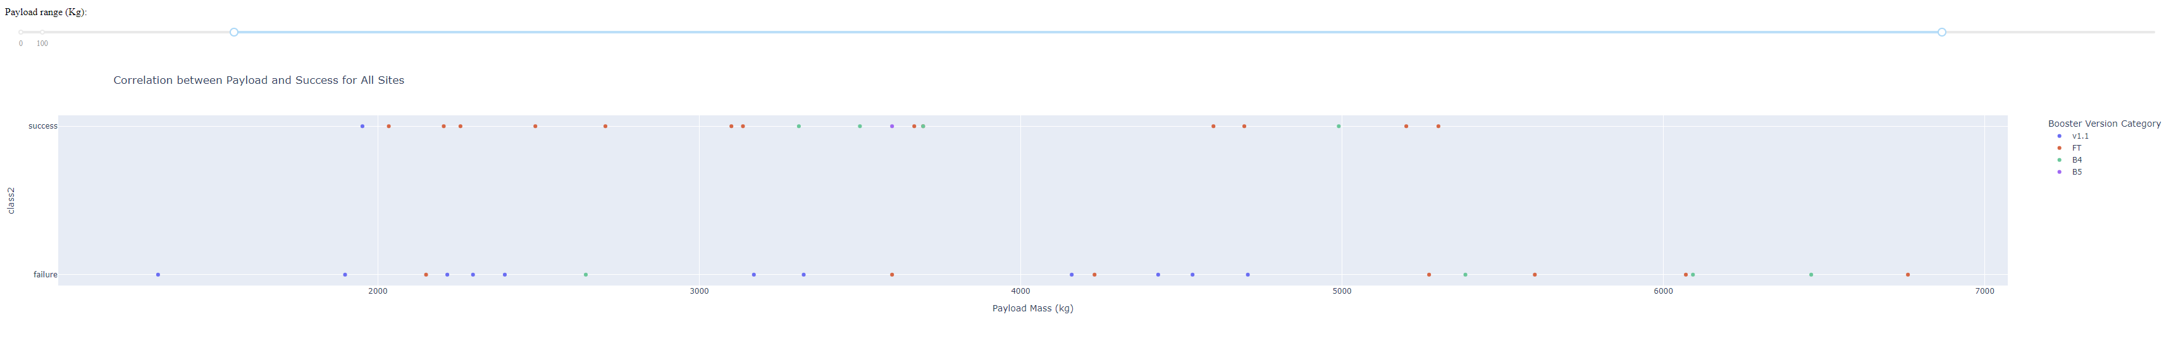
Payload vs. Launch Outcome for All Sites (1000 - 7000)
In the payload range of 1000kg to 7000kg there were more failures than successes. In this range, booster version FT seems to have the highest success rate.

Slide 42

Section 5

Slide 43
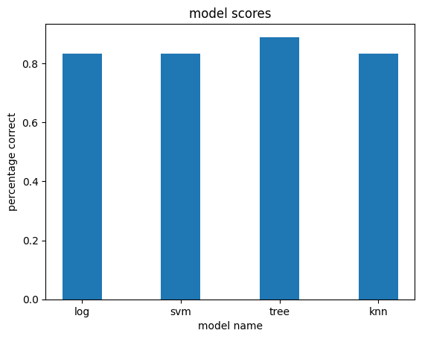
Classification Accuracy
Visualize the built model accuracy for all built classification models, in a bar chart
Out of all 4 models, the tree model had the highest classification score of 0.88888

Slide 44
Confusion Matrix
This is the confusion for the tree model which scored the best.
Its FP and FN scores are the same.
It guessed mostly correct with TP and TN

Slide 45
Conclusions
Higher payloads tend to be more successful compared to lower ones.
Launches have been becoming more successful over time. KSC LC-39A seems to be the best launch site.
Florida seems to be better location to launch rockets.
For predicting launch outcomes, a tree-based model would be the best solution.

Slide 46


